Slide 1

Student Dropout and Academic Success Analysis

Slide 2

1. Introduction
Student retention is a critical focus for academic institutions. Dropping out can have long-term effects on an individual’s career and mental health, and also affects institutional rankings and funding. This project aims to analyze a student dataset to understand the academic and socio-economic factors that influence whether a student drops out, graduates, or remains enrolled.

Slide 3
2. Objective
The primary objective of this study is to:
• Explore patterns in student performance and behavior.
• Identify key indicators correlated with student dropout.
• Generate insights to help educational institutions improve retention strategies.

Slide 4
3. Dataset Description
Feature
Description
TargetDropout / Graduate / Enrolled
Admission grade
Grade received at time of admission
Age at enrollment
Age of the student when joining the course

Slide 5
GDP
Curricular units 1st sem
Enrolled, evaluated, approved, and grade count for 1st semester
Curricular units 2nd sem
Same as above for 2nd semester
Unemployment rate
Country-wide unemployment at time of enrollment
Inflation rate
Inflation rate at enrollment time
Gross Domestic Product of the country
Qualification prior to current course

Slide 6
4. Data Preprocessing
Formatting Fixes:
Resolved delimiter issues
Cleaned inconsistent or irregular entries
2. Type Conversions:
Converted numerical columns (grades, age) to appropriate types
3. Missing Value Handling:
Detected and handled nulls or blanks using:
Mean/median imputation
Row/column removal
4. Feature Engineering
Aggregated or created new fields for better analysis (e.g., performance score)

Slide 7
5. Exploratory Data Analysis
1. Target Distribution:
Graduates: Majority
Enrolled: Moderate
Dropouts: Minority
2. Correlation Analysis:
Strong correlation between 1st and 2nd semester performance (~0.79)
Mild positive link between admission grade and academic performance
Weak negative correlation between GDP and unemployment rate

Slide 8
3. Insights:
Curricular performance is the strongest indicator of academic success
Younger students show higher graduation rates
Economic factors have minimal direct academic correlation but potential indirect effects

Slide 9
6. Feature Engineering & Selection
Identifying Key Influencers: Grades, Age, and More
Methods of Feature Selection: Picking the Best VariablesBuilding Predictive Models
Diving into Algorithms: Logistic Regression, Decision Trees, and More
Training and Testing: How We Validate Our ModelsEvaluating Model Performance
Key Metrics: Accuracy, Precision, Recall, and F1 Score

Slide 10
7. Evaluation Metrics
Accuracy: Measure of correct predictions.
Precision: True positive rate of positive classes.
Recall: True positive rate of actual positives.
F1-score: Harmonic mean of precision and recall for imbalance classification.
ROC-AUC: Measures the ability of a model to distinguish between classes.

Slide 11
Accuracy

Slide 12
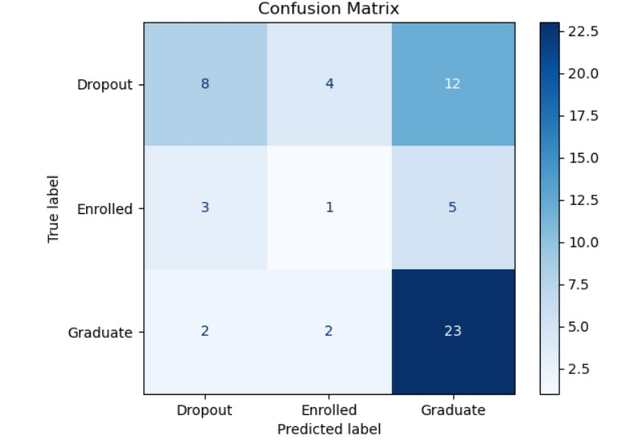
Confusion matrix

Slide 13
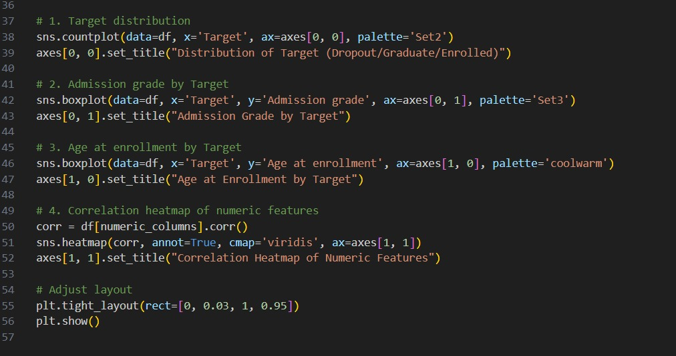
Implementation

Slide 14
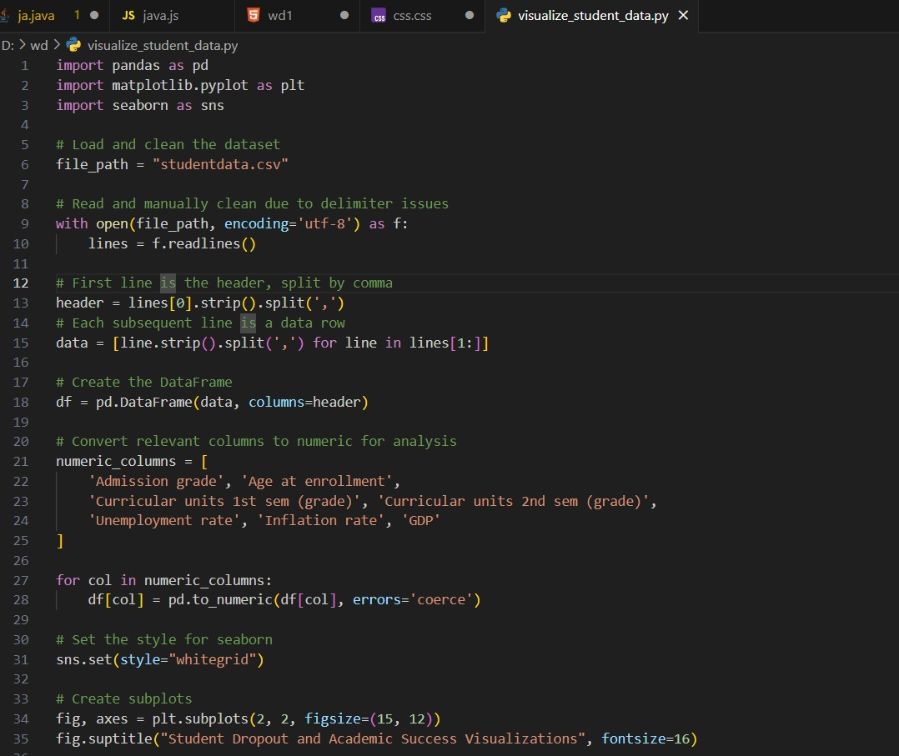
Implementation

Slide 15
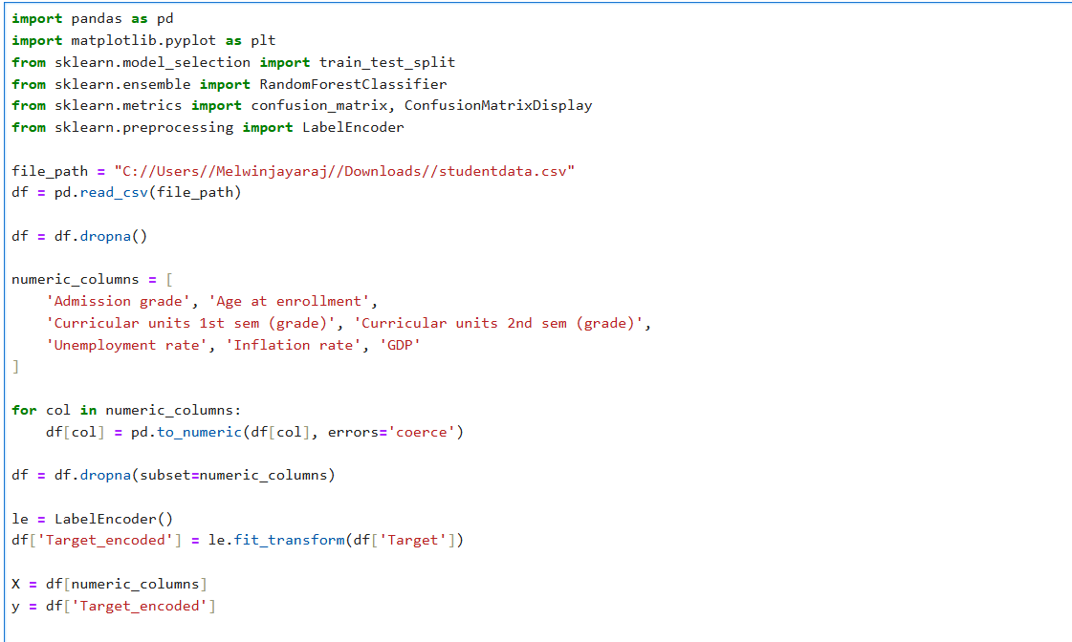
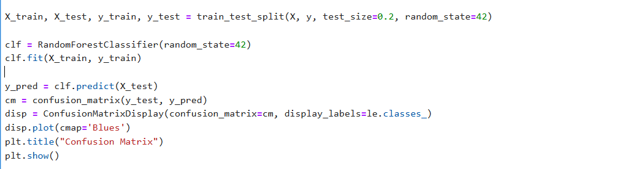
Implementation

Slide 16
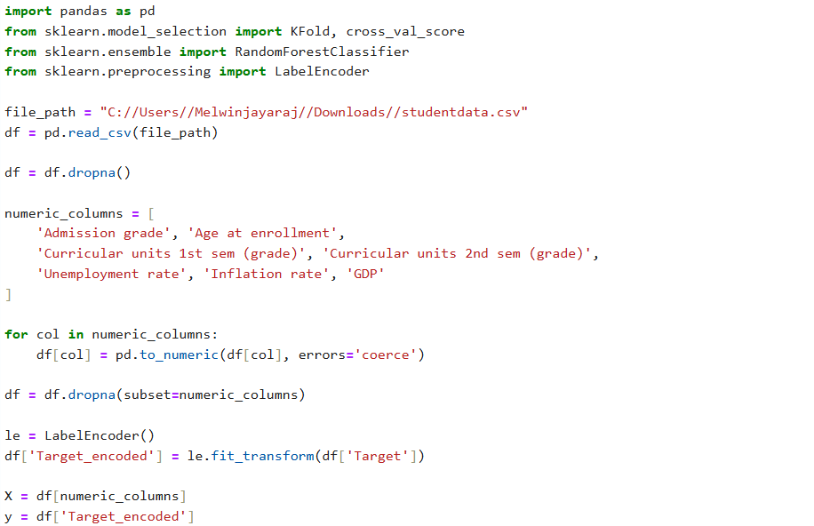
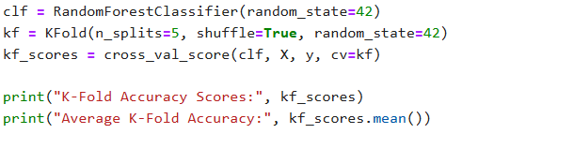
Implementation

Slide 17
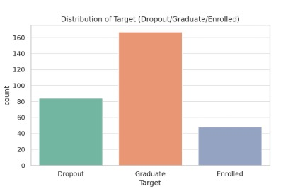
Visualization
The majority of students in the dataset graduated, while a smaller portion dropped out or are still enrolled. This shows a positive trend in student outcomes, with graduation being the most common result.

Slide 18
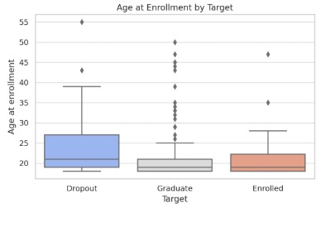
Visualization
Students who dropped out were generally older at the time of enrollment compared to those who graduated or are still enrolled. This might indicate that older students face more challenges in completing their studies.

Slide 19
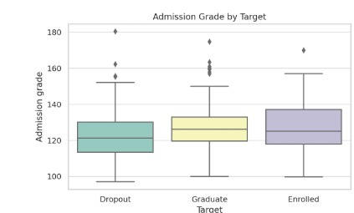
Visualization
Admission grades are relatively similar across all categories, though enrolled students show slightly higher median grades. This suggests that academic readiness alone may not fully predict dropout or graduation.

Slide 20
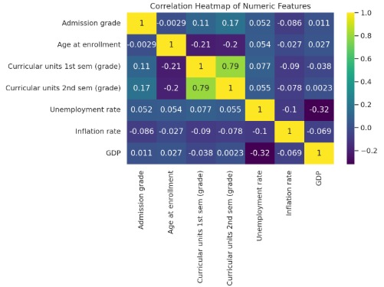
Visualization
Strong positive correlation is seen between first and second semester grades. However, age at enrollment and economic indicators like inflation and unemployment show minimal correlation with academic performance.

Slide 21
Analysis Summary
Curricular unit performance is the strongest indicator of academic success.
Younger age at enrollment is associated with higher chances of graduation.
Economic indicators like GDP and inflation might have secondary influence.
Admission grades, while informative, don’t show major predictive power in isolation.

Slide 22
Conclusion and Future Work
This analysis offers a foundation for predictive modeling (e.g., using machine learning classifiers) to:
Predict the likelihood of dropout or graduation.
Identify students at risk early in their academic journey.
Future enhancements:
Build a classification model (e.g., Random Forest, SVM).
Incorporate time-series tracking of performance.
Add more qualitative data (like student satisfaction surveys).

Slide 23
Team members
Jawad
Zarif
Melwin
Mirfa
Afkar
Ansar

Slide 24

Thank you

